Slide 1
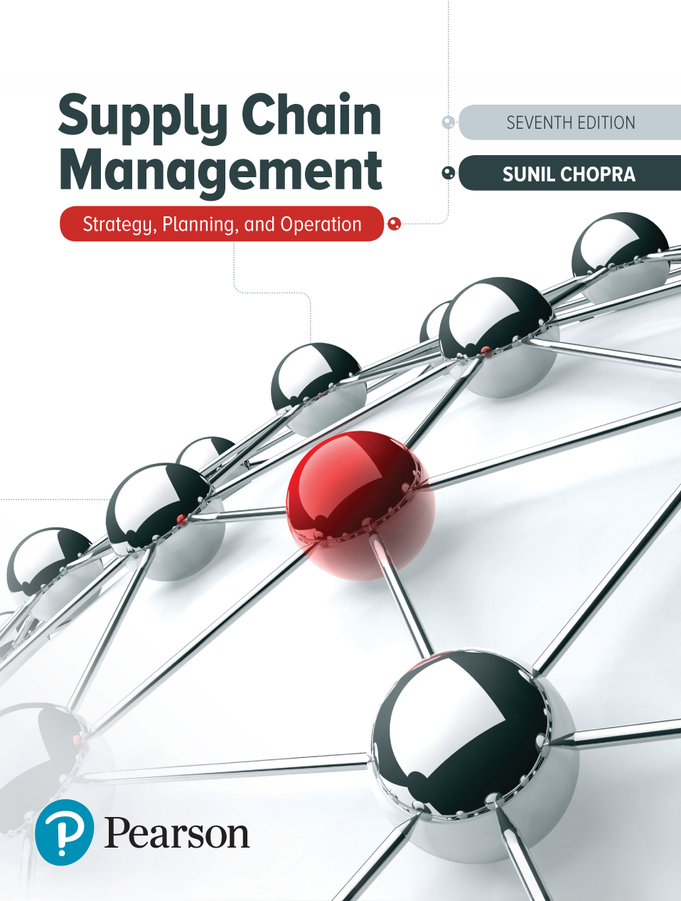
Supply Chain Management: Strategy, Planning, and Operation
Seventh Edition
Chapter 13
Linking Product Availability to Profits
Copyright © 2019, 2016, 2013 Pearson Education, Inc. All Rights Reserved
Notes:
If this PowerPoint presentation contains mathematical equations, you may need to check that your computer has the following installed:
1) MathType Plugin
2) Math Player (free versions available)
3) NVDA Reader (free versions available)

Slide 2
Learning Objectives (1 of 2)
13.1 Identify the factors affecting the optimal level of product availability.
13.2 Evaluate the cycle service level that maximizes profits.
13.3 Use basic managerial levers that improve supply chain profitability.
13.4 Discuss how speed can improve profits in a supply chain.

Slide 3
Learning Objectives (2 of 2)
13.5 Understand conditions under which postponement is valuable in a supply chain.
13.6 Allocate limited supply capacity among multiple products to maximize expected profits.

Slide 4
Factors Affecting the Desired Level of Product Availability (1 of 2)
Product availability or customer service level measured by cycle service level or fill rate
Product availability affects supply chain responsiveness
Trade-off:
High levels of product availability ➔ increased responsiveness and higher revenues
High levels of product availability ➔ increased inventory levels and higher supply chain costs
Product availability is related to profit objectives and strategic and competitive issues

Slide 5
L . L. Bean Example (1 of 4)
Table 13-1 Demand Distribution for Parkas at L. L. Bean
Demand D_{i} (in hundreds) | Probability p_{i} | Cumulative Probability of Demand Being D_{i} or Less (P_{i}) | Probability of Demand Being Greater than D_{i}(1 − P_{i})
4 | 0.01 | 0.01 | 0.99
5 | 0.02 | 0.03 | 0.97
6 | 0.04 | 0.07 | 0.93
7 | 0.08 | 0.15 | 0.85
8 | 0.09 | 0.24 | 0.76
9 | 0.11 | 0.35 | 0.65
10 | 0.16 | 0.51 | 0.49
11 | 0.20 | 0.71 | 0.29
12 | 0.11 | 0.82 | 0.18
13 | 0.10 | 0.92 | 0.08
14 | 0.04 | 0.96 | 0.04
15 | 0.02 | 0.98 | 0.02
16 | 0.01 | 0.99 | 0.01
17 | 0.01 | 1.00 | 0.00

Slide 6
L . L. Bean Example (2 of 4)
Expected profit
from extra 100 parkas
– 500 × Prob(demand < 1,100)
= $5,500 × 0.49 − $500 × 0.51 = $2,440
Expected profit from
ordering 1,300 parkas
= $49,900 + $2,440 + $1,240 + $580
= $54,160

Slide 7
L . L. Bean Example (3 of 4)
Table 13-2 Expected Marginal Contribution of Each Additional 100 Parkas
Additional Hundreds | Expected Marginal Benefit | Expected Marginal Cost | Expected Marginal Contribution
11th | 5,500 × 0.49 = 2,695 | 500 × 0.51 = 255 | 2,695 − 255 = 2,440
12th | 5,500 × 0.29 = 1,595 | 500 × 0.71 = 355 | 1,595 − 355 = 1,240
13th | 5,500 × 0.18 = 990 | 500 × 0.82 = 410 | 990 − 410 = 580
14th | 5,500 × 0.08 = 440 | 500 × 0.92 = 460 | 440 − 460 = −20
15th | 5,500 × 0.04 = 220 | 500 × 0.96 = 480 | 220 − 480 = −260
16th | 5,500 × 0.02 = 110 | 500 × 0.98 = 490 | 110 − 490 = −380
17th | 5,500 × 0.01 = 55 | 500 × 0.99 = 495 | 55 − 495 = −440

Slide 8
L . L. Bean Example (4 of 4)
Figure 13-1 Expected Profit as a Function of Order Quantity at L. L. Bean

Slide 9
Factors Affecting the Desired Level of Product Availability (2 of 2)
Cost of overstocking, C_{o}
Cost of understocking, C_{u}
Possible scenarios
Seasonal items with a single order in a season
One-time orders in the presence of quantity discounts
Continuously stocked items
Demand during stockout is backlogged
Demand during stockout is lost

Slide 10
Summary of Learning Objective 1
The optimal level of product availability is affected by the cost of overstocking and the cost of understocking. The cost of overstocking refers to the loss incurred when the supply chain has an unsold unit of the product. The cost of understocking refers to the current and future margin lost when the supply chain turns away one unit of demand because it is short of the product.

Slide 11
Optimal Cycle Service Level for Seasonal Items – Single Order (1 of 4)
C_{o}: Cost of overstocking by one unit, C_{o} = c − s
C_{u}: Cost of understocking by one unit, C_{u} = p − c
C S L*: Optimal cycle service level
O*: Corresponding optimal order size
Expected benefit of purchasing extra unit = (1 − CSL*)(p − c)
Expected cost of purchasing extra unit = CSL*(c – s)
Expected marginal contribution of raising order size = (1 − CSL*)(p − c) − CSL*(c − s)

Slide 12
Optimal Cycle Service Level for Seasonal Items – Single Order (2 of 4)

Slide 13
Optimal Cycle Service Level for Seasonal Items – Single Order (3 of 4)

Slide 14
Optimal Cycle Service Level for Seasonal Items – Single Order (4 of 4)
Figure 13-2 Impact on Optimal Cycle Service Level of Changing

Slide 15
Evaluating the Optimal Service Level for Seasonal Items (1 of 3)
disposal value = $85, holding cost = $5
Salvage value = $85 – $5 = $80
Cost of understocking = C_{u} = p − c = $250 − $100 = $150
Cost of overstocking = C_{o} = c − s = $100 − $80 = $20

Slide 16
Evaluating the Optimal Service Level for Seasonal Items (2 of 3)

Slide 17
Evaluating the Optimal Service Level for Seasonal Items (3 of 3)

Slide 18
Evaluating Expected Overstock and Understock
μ = 350, σ = 100, O = 450

Slide 19
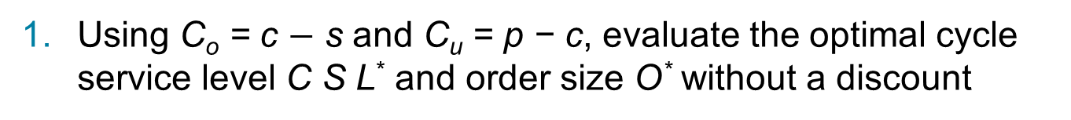
One-Time Orders in the Presence of Quantity Discounts (1 of 2)
Using C_{o} = c $−$ s and C_{u} = p − c, evaluate the optimal cycle service level C S L* and order size O* without a discount
Evaluate the expected profit from ordering O*
Using C_{o} = c_{d} − s and C_{u} = p − c_{d}, evaluate the optimal cycle
service level
and order size
with a discount
If
evaluate the expected profit from ordering
If
evaluate the expected profit from ordering K
units

Slide 20
One-Time Orders in the Presence of Quantity Discounts (2 of 2)
Order O* units if the profit in step 1 is higher
If the profit in step 2 is higher, order
units if
or K units if

Slide 21
Evaluating Service Level with Quantity Discounts (1 of 2)
Step 1, c = $50
Cost of understocking = C_{u} = p − c = $200 − $50 = $150
Cost of overstocking = C_{o} = c − s = $50 − $0 = $50
Expected profit from ordering 177 units = $19,958

Slide 22
Evaluating Service Level with Quantity Discounts (2 of 2)
Step 2, c = $45
Cost of understocking = C_{u} = p − c = $200 − $45 = $155
Cost of overstocking = C_{o} = c − s = $45 − $0 = $45
Expected profit from ordering 200 units = $20,595

Slide 23
Desired Cycle Service Level for Continuously Stocked Items (1 of 2)
Two extreme scenarios
All demand that arises when the product is out of stock is backlogged and filled later, when inventories are replenished
All demand arising when the product is out of stock is lost

Slide 24
Desired Cycle Service Level for Continuously Stocked Items (2 of 2)
Q: Replenishment lot size
S: Fixed cost associated with each order
R O P: Reorder point
D: Average demand per unit time
σ_{D}: Standard deviation of demand per unit time
ss: Safety inventory (ss = R O P − D_{L})
C S L: Cycle service level
C: Unit cost
h: Holding cost as a fraction of product cost per unit time
H: Cost of holding one unit for one unit of time. H = hC

Slide 25
Demand During Stockout Is Backlogged (1 of 4)
Increased cost per replenishment cycle of additional safety inventory of 1 unit
Benefit per replenishment cycle of additional safety inventory of 1 unit = (1 − CSL)C_{u}

Slide 26
Demand During Stockout Is Backlogged (2 of 4)
Lot size, Q = 400 gallons
Reorder point, R O P = 300 gallons
Average demand per year, D = 100 × 52 = 5,200
Standard deviation of demand per week,
Unit cost, C = $3
Holding cost as a fraction of product cost per year, h = 0.2

Slide 27
Demand During Stockout Is Backlogged (3 of 4)
Cost of holding one unit for one year, H = hC = $0.6
Lead time, L= 2 weeks
Mean demand over lead time, D_{L} = 200 gallons
Standard deviation of demand over lead time,

Slide 28
Demand During Stockout Is Backlogged (4 of 4)

Slide 29
Evaluating Optimal Service Level When Unmet Demand Is Lost
Lot size, Q= 400 gallons
Average demand per year, D = 100 × 52 = 5,200
Cost of holding one unit for one year, H = $0.6
Cost of understocking, C_{u}= $2

Slide 30
Summary of Learning Objective 2
For seasonal products, the optimal level of product availability is
given by
, where C_{o} is the cost of overstocking and Cu
is the cost of understocking. For continuously stocked products,
the optimal cycle service level is given by
if all unmet
demand is backlogged. For continuously stocked products, the
optimal cycle service level is given by
if all unmet
demand is lost. As the cost of overstocking increases, it is optimal to lower the targeted level of product availability. As the lost margin from being out of stock increases, it is optimal to raise the targeted level of product availability.

Slide 31
Managerial Levers to Improve Supply Chain Profitability
Three basic managerial levers
Increase salvage value of each unit
Sell to outlet stores
Decrease the margin lost from a stockout
Backup sourcing
Substitute products
Decrease the uncertainty of demand
Improved forecasts

Slide 32
Improved Forecasts
Improved forecasts result in reduced uncertainty
Less uncertainty results in
Lower levels of safety inventory (and costs) for the same level of product availability, or
Higher product availability for the same level of safety inventory, or
Both

Slide 33
Impact of Improved Forecasts (1 of 3)
Demand: μ = 350, σ = 150
Cost: c = $100, Price: p = $250, Salvage: s = $80
Cost of understocking = C_{u} = p − c = $250 − $100 = $150
Notes:
Note:
Cost of understocking = 250-100 = $150
Cost of overstocking = 100+5-85 = $20
p = 150/(150+20) = 0.88
Order size = 426

Slide 34
Impact of Improved Forecasts (2 of 3)
Table 13-3 Expected Profit and Order Size at Bloomingdale’s
Standard Deviation of Forecast Error σ | Optimal Order Size O* | Expected Overstock | Expected Understock | Expected Profit
150 | 526 | 186.7 | 8.6 | $47,469
120 | 491 | 149.3 | 6.9 | $48,476
90 | 456 | 112.0 | 5.2 | $49,482
60 | 420 | 74.7 | 3.5 | $50,488
30 | 385 | 37.3 | 1.7 | $51,494
0 | 350 | 0 | 0 | $52,500
Notes:
Note:
Cost of understocking = 250-100 = $150
Cost of overstocking = 100+5-85 = $20
p = 150/(150+20) = 0.88
Order size = 426

Slide 35
Impact of Improved Forecasts (3 of 3)
Figure 13-3 Variation of Profit and Inventories with Forecast Accuracy
Notes:
Note:
Cost of understocking = 250-100 = $150
Cost of overstocking = 100+5-85 = $20
p = 150/(150+20) = 0.88
Order size = 426

Slide 36
Summary of Learning Objective 3
Supply chain profits can be increased by decreasing the cost of overstocking through the use of outlet channels. Profits can also be increased by decreasing the cost of understocking by providing substitute products or arranging for emergency supply sources (even if they are more expensive). Supply chain profits also increase if the underlying uncertainty of demand can be decreased. A decrease in forecast error decreases both the expected overstock and expected understock.

Slide 37
The Value of Speed in a Seasonal Supply Chain
Quick response: the set of actions taken by managers to reduce replenishment lead time
Reduced lead time results in improved forecast accuracy
Benefits
Lower order quantities thus less inventory with same product availability
Less overstock
Higher profits

Slide 38
Quick Response: Multiple Orders Per Season (1 of 5)
Ordering shawls at a department store
Selling season = 14 weeks
Cost per shawl c = $40
Retail price p = $150
Disposal price s = $30
Holding cost = $2 per week
Expected weekly demand D = 20
Standard deviation

Slide 39
Quick Response: Multiple Orders Per Season (2 of 5)
Two ordering policies
Supply lead time is more than 15 weeks
Single order placed at the beginning of the season
Supply lead time is reduced to six weeks
Two orders are placed for the season
One for delivery at the beginning of the season
One at the end of week 1 for delivery in week 8

Slide 40
Single Order Policy (1 of 2)

Slide 41
Single Order Policy (2 of 2)
Expected profit with a single order = $29,767
Expected overstock = 79.8
Expected understock = 2.14
Cost of overstocking = $10
Cost of understocking = $110
Expected cost of overstocking = 79.8 × $10 = $798
Expected cost of understocking = 2.14 × $110 = $235

Slide 42
Two Order Policy
Expected profit from seven weeks = $14,670
Expected overstock = 56.4
Expected understock = 1.51
Expected profit from seven weeks

Slide 43
Quick Response: Multiple Orders Per Season (3 of 5)
Three important consequences
The expected total quantity ordered during the season with two orders is less than that with a single order for the same cycle service level
The average overstock to be disposed of at the end of the sales season is less if a follow-up order is allowed after observing some sales
The profits are higher when a follow-up order is allowed during the sales season

Slide 44
Quick Response: Multiple Orders Per Season (4 of 5)
Figure 13-4 Leftover Inventory Versus Number of Order Cycles per Season

Slide 45
Quick Response: Multiple Orders Per Season (5 of 5)
Figure 13-5 Expected Profit Versus Number of Order Cycles per Season

Slide 46
Two Order Policy with Improved Forecast Accuracy
Expected profit from second order = $15,254
Expected overstock = 11.3
Expected understock = 0.30
Expected profit from season

Slide 47
Summary of Learning Objective 4
Speed in replenishment allows a retailer to place multiple orders in a selling season. Multiple replenishments allow the supply chain to better match supply and demand by being able to respond to trends rather than having to forecast them. The resulting decrease in overstock and understock quantities increases profits.

Slide 48
The Value of Postponement in a Seasonal Supply Chain
Delay of product differentiation until closer to the sale of the product
Activities prior to product differentiation require aggregate forecasts more accurate than individual product forecasts
Individual product forecasts are needed close to the time of sale
Results in a better match of supply and demand
Valuable in online sales
Higher profits through better matching of supply and demand

Slide 49
Value of Postponement: Benetton (1 of 7)
For each of four colors
Demand μ = 1,000, σ = 500
Sale price p = $50, Salvage value s = $10
Production cost Option 1 (no postponement) = $20
Production cost Option 2 (postponement) = $22

Slide 50
Value of Postponement: Benetton (2 of 7)
Option 1, for each color
Expected profits = $23,664
Expected overstock = 412
Expected understock = 75
Total production = 4 × 1,337 = 5,348
Expected profit = 4 × $23,644 = $94,576

Slide 51
Value of Postponement: Benetton (3 of 7)
Option 2, for all sweaters
Expected profits = $98,092
Expected overstock = 715
Expected understock = 190

Slide 52
Value of Postponement: Benetton (4 of 7)
Table 13-4 Impact of Demand Uncertainty and Correlation on Value of Postponement
Mean Demand per Color | SD of Demand per color | Correlation Coefficient ρ | Expected profit Without Postponement | Expected Profit With Postponement
1,000 | 500 | 0 | $94,578 | $98,902
1,000 | 500 | 0.15 | $94,578 | $95,253
1,000 | 500 | 0.20 | $94,578 | $94,408
1,000 | 500 | 0.25 | $94,578 | $93,602
1,000 | 350 | 0 | $102,205 | $102,265
1,000 | 300 | 0 | $104,747 | $103,655
1,000 | 250 | 0 | $107,289 | $105,046

Slide 53
Value of Postponement: Benetton (5 of 7)
Postponement is not very effective if a large fraction of demand comes from a single product
Option 1
Expected profits_{red} = $82,831
Expected overstock = 659
Expected understock = 119

Slide 54
Value of Postponement: Benetton (6 of 7)
Other colors μ = 300, σ = 200
Expected profits_{other} = $6,458
Expected overstock = 165
Expected understock = 30
Total production = 3,640 + 3 × 435 = 4,945
Expected profit = $82,831 + 3 × $6,458 = $102,205
Expected overstock = 659 + 3 × 165 = 1,154
Expected understock = 119 + 3 × 30 = 209

Slide 55
Value of Postponement: Benetton (7 of 7)
Option 2
Total production = 4,475
Expected profit = $99,872
Expected overstock = 623
Expected understock = 166

Slide 56
Tailored Postponement: Impact on Profits and Inventories
Use production with postponement to satisfy a part of demand, the rest without postponement
Produce red sweaters without postponement, postpone all others
Profit = $103,213
Tailored postponement allows a firm to increase profits by postponing differentiation only for products with uncertain demand

Slide 57
Tailored Postponement: Benetton (1 of 2)
Separate all demand into base load and variation
Base load manufactured without postponement
Variation is postponed
Four colors
Identify base load and variation for each color

Slide 58
Tailored Postponement: Benetton (2 of 2)
Table 13-5 Average of 500 Simulations for Tailored Postponement Policies
Manufacturing Policy | Manufacturing Policy | Blank | Blank | Blank
Q₁ | Q_{A} | Average Profit | Average Overstock | Average Understock
0 | 4,524 | $97,847 | 510 | 210
1,337 | 0 | $94,377 | 1,369 | 282
700 | 1,850 | $102,730 | 308 | 168
800 | 1,550 | $104,603 | 427 | 170
900 | 950 | $101,326 | 607 | 266
900 | 1,050 | $101,647 | 664 | 230
1,000 | 850 | $100,312 | 815 | 195
1,000 | 950 | $100,951 | 803 | 149
1,100 | 550 | $99,180 | 1,026 | 211
1,100 | 650 | $100,510 | 1,008 | 185

Slide 59
Summary of Learning Objective 5 (1 of 2)
Postponement allows a firm to increase profits and better match supply and demand if the firm produces a large variety of products whose demand is unpredictable, not positively correlated, and of about the same size. The value of postponement decreases as uncertainty decreases or demand is positively correlated across end products. Postponement may reduce overall profits for a firm if a single product contributes the majority of the demand because the increased manufacturing expense due to postponement outweighs the small benefit that aggregation provides in this case for the dominant product.

Slide 60
Summary of Learning Objective 5 (2 of 2)
In such settings, tailored postponement allows a firm to increase its profitability by postponing only the uncertain part of the demand and producing the predictable part at a lower cost without postponement. Tailored postponement is more profitable than either no postponement or complete postponement but can be complex to implement.

Slide 61
Setting Product Availability for Multiple Products under Capacity Constraints (1 of 4)
Two styles of sweaters from Italian supplier
High end | Mid-range
mu sub1 = 1,000 | _{mu sub 2 = 2,000}
sigma sub 1 = 300 | sigma sub 2 = 400
p₁ = $150 | p₂ = $100
c₁ = $50 | c₂ = $40
s₁ = $35 | s₂ = $25
CSL = 0.87 | CSL = 0.80
O = 1,337 | O = 2,337

Slide 62
Setting Product Availability for Multiple Products under Capacity Constraints (2 of 4)
Supplier capacity constraint, 3,000 units

Slide 63
Setting Product Availability for Multiple Products under Capacity Constraints (3 of 4)
Set quantity Q_{i} = 0 for all products i
Compute the expected marginal contribution M C_{i}(Q_{i}) for each product i
If positive, stop, otherwise, let j be the product with the highest expected marginal contribution and increase Q_{j} by one unit
If the total quantity is less than B, return to step 2, otherwise capacity constraint are met and quantities are optimal

Slide 64
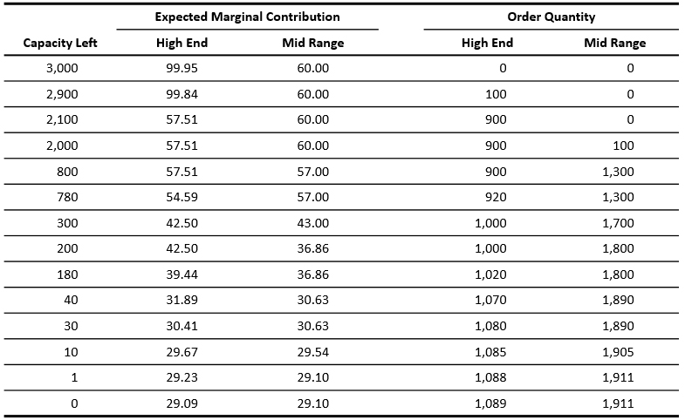
Setting Product Availability for Multiple Products under Capacity Constraints (4 of 4)
Table 13-6 Application of Solution Procedure to Obtain Order Quantities Under Capacity Constraints

Slide 65
Summary of Learning Objective 6
When ordering multiple products under a limited supply capacity, the allocation of capacity to products should be based on their expected marginal contribution to profits. This approach allocates a relatively higher fraction of capacity to products that have a high margin relative to their cost of overstocking. At the optimal allocation, the expected marginal contribution of each product is the same. When there is no capacity constraint, the expected marginal contribution of each product at optimality is zero.

Slide 66

Copyright

